Slide 1
Liability Workshop
Blockchain & Legal Innovation I – Tutorial 2

Slide 2
What Issues Arise?
You want to launch a Proof of Work meme (purposeless) coin similar to Doge.
You and your friends plan to mine the tokens yourselves for 6 months before making the code base open source
You plan to pre-sell some tokens to fund your development

Slide 3
What Issues Arise?
You want to launch a Proof of Stake chain for smart contracts because proof of work is too slow.
The more of your token nodes stake, the more chance of earning a token and winning a block. Malicious nodes have their stake slashed.
You and your friends plan to pre-mint tokens yourselves when the code base open source
You plan to pre-sell some tokens to fund your development
What if you launched it as PoW and moved to PoS later?

Slide 4
What Issues Arise?
You want to launch a UNL Consensus chain for smart contracts, like the XRPL.
You need to publish a default UNL of around 34 trusted nodes to help protect the network against unintended forks.
You and your friends plan to pre-mint all tokens and then distribute them.
You plan to pre-sell some tokens to fund your development

Slide 5
Case Study - Evernode
Global. Permissionless. Flexible. Fast. Scalable.
“Layer 2” Network of HotPocket Nodes
Composed from the XRP Ledger
Incentivised to Host DApps
Utilises DEX and Hooks

Slide 6
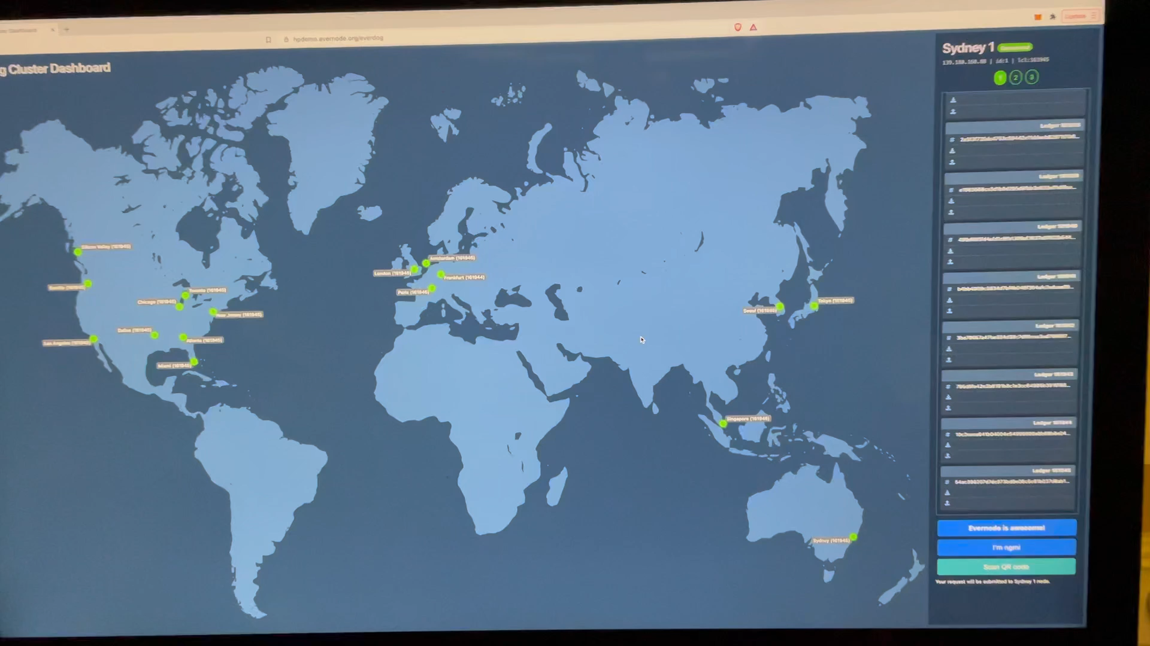
Global. Permissionless. Flexible. Fast. Scalable.
https://hpdemo.evernode.org/everdog

Slide 7
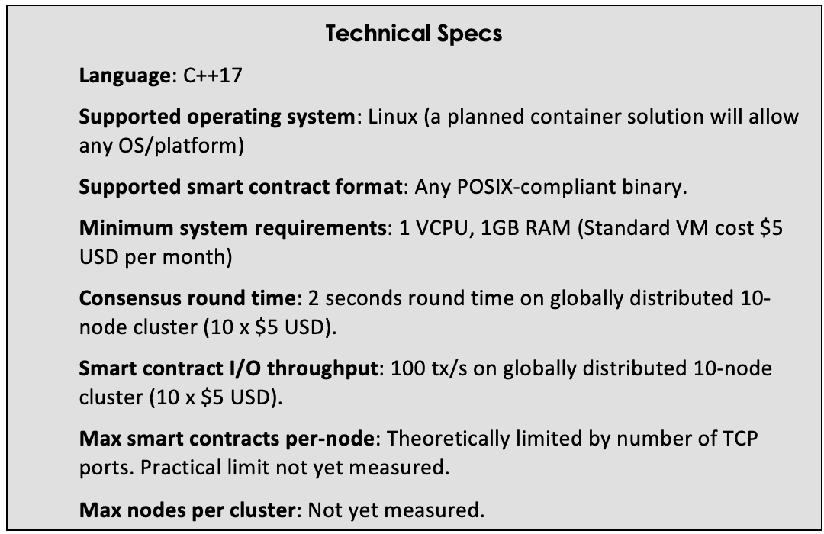
HotPocket –Evernode’s Beating Heart
UNL Consensus Protocol: Enforces consensus rules on inputs and outputs and maintains a shared, canonical state.
Rapid State Sync: A bundle of features to make it as easy to spin up a HotPocket Node.
Contract Lifecycle Management: Ensures all contracts have the same configuration and allows contracts to be upgraded automatically at consensus.
Daemon (called Sashimono): Co-ordinates the cluster through encrypted messages posted to the layer 1 chain.
Minimal setup: New nodes need minimal information to sync with a cluster.

Slide 8
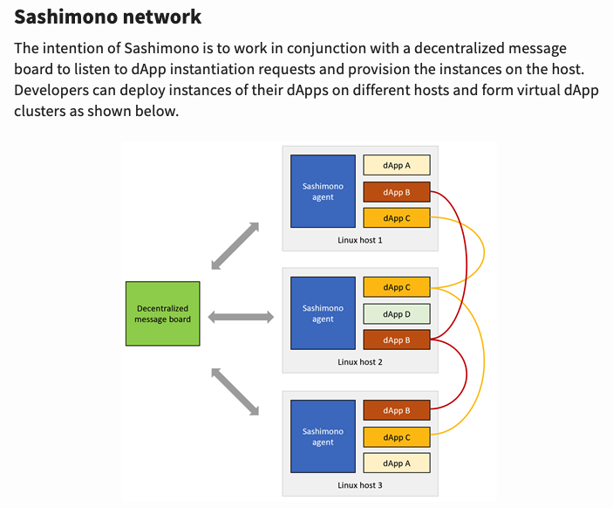



Layer 2 HotPocket Network

Slide 9
Benefits
Nature
Benefits
HotPocket dApps don’t run on blockchains, they are blockchains. Each dApp is its own blockchain with its own chain history and dedicated nodes, making them flexible.
DApps may be public or private. DApps may call external services, read and write data directly to disk and the web, and generally perform any task a regular program can, without centralisation or trusted third parties and without requiring the programmer to implement their own consensus mechanisms.
Privacy Compliance: dApps can encrypt data, run only on hosts with required privacy features.
Scale & Flexibility: dApps can run on as few or as many hosts as desired for cost/security.
On-Demand Oracles: dApps can elect a jury of peers to get and agree on off-chain truth.
Enhanced Security: dApps can detect and shut down unreliable instances and reload it on a new, more trusted Node.

Slide 10
Nice Tech, But So What…?
How Are You Going To Use It?
Own Network vs L2 on Existing L1
Own Token vs L1 Token
Token Distribution Mechanism?

Slide 11
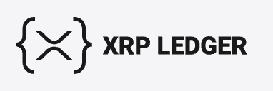
Network = L2 on XRPL

Slide 12
Why XRPL
XRP Ledger Benefits
Existing Ecosystem Benefits
Speedy
Cheap
Reliable
Secure
Native DEX
Integration: Avoid the need to build an independent ecosystem of wallets, browser plug-ins, and explorers.
No dUNL: Avoid the need for a separate dUNL and all the complications that come with specifying, identifying, and incentivising a decentralised dUNL.

Slide 13
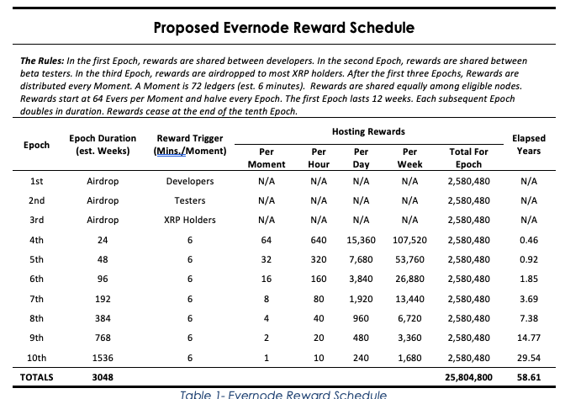
Evers – Native Token
Name: Evers
Ticker: EVRS
Smallest Unit: a “Now”. 1 Now = 0.00000001 Evers.
Distribution Mechanism: Airdrops plus Rewards to reliable nodes
Reward Trigger: Every Moment = every 72 ledgers (est. six minutes)
Maximum Supply: 25,804,800
Emission Timeframe: ~59.61 years

Slide 14





Hosting Tokens
Name: Hosting Tokens
Ticker: Unique to each host
Smallest Unit: 1 (non-divisible)
Distribution Mechanism: Minted by Host and traded on DEX for Evers
Memo field: Used to described host specs
Purpose: Redeemed by DApps for 1 Moment (six minutes) of Hosting
Emissions: Dependent on host
HTK
DApp
Host
EVRS

Slide 15
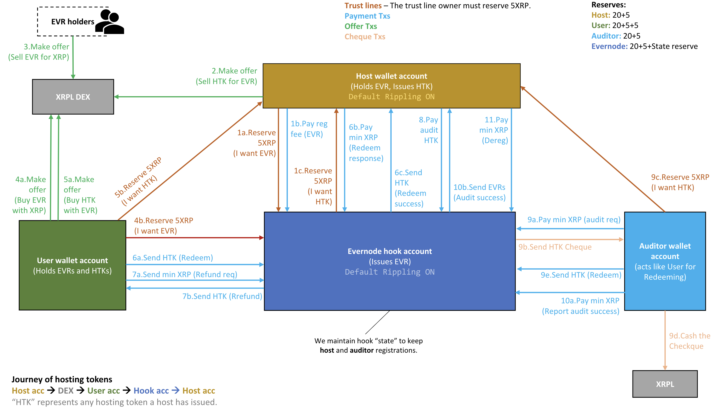

Slide 16
Token Distribution
Has Caused Biggest Headache
Want to incentivise Hosts to exist ahead of dApps
BUT How to protect against malicious Hosts?

Slide 17
Where We Landed
Mint All Tokens At Launch
Airdrop some
NFP Foundation Will Use Remainder to Buy Hosting for a Community Contract
Hosting Purchase Regime Becomes Distribution Mechanism

